Slide 1


Analysis of Variance
Ruchi Dilip Kukde, Neeraj Kumar Reddy Panta

Slide 2
We consider 500 samples from the original dataset for ANOVA
Goal: Understanding relationship between time in hospital and number of medications

Slide 3
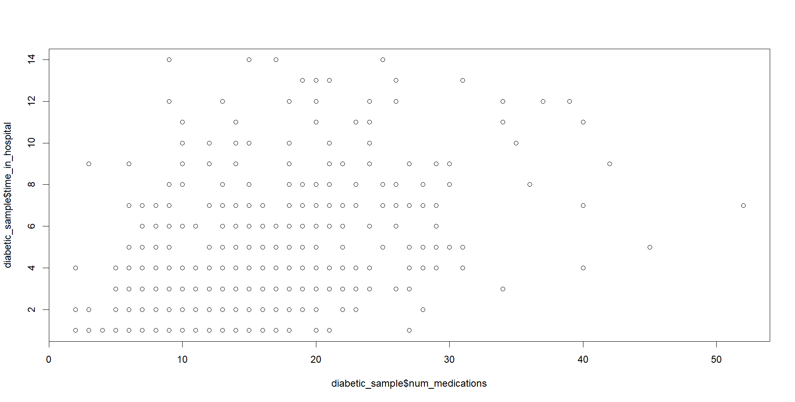

Slide 4
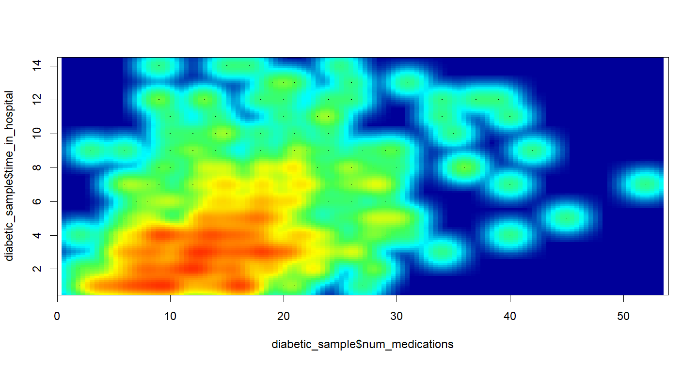

Slide 5


Slide 6
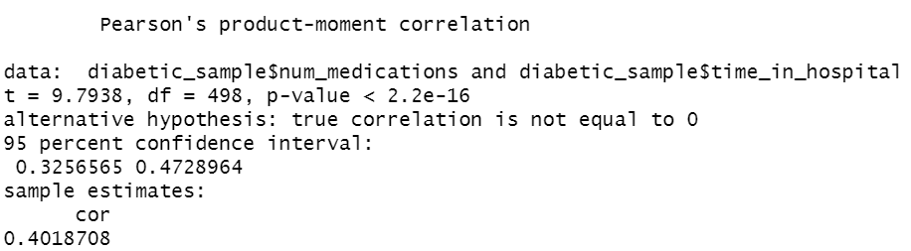

Slide 7

Linear Regression Model
Outcome - time_in_hospital $\hat{Y}$
Predictor - Num_medications $X_{1}$
Equation of the model:$\hat{Y}=b_{1}X_{1}+b_{0}$

Slide 8
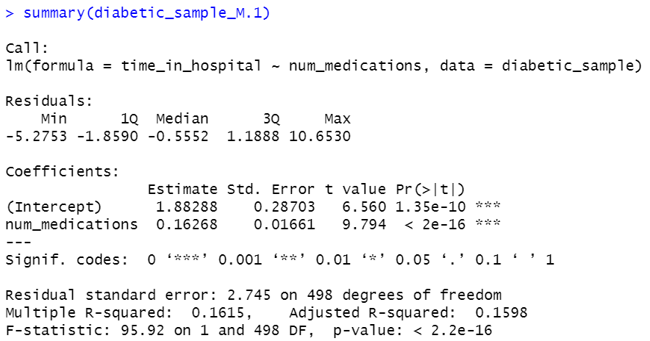

Slide 9
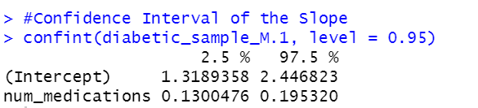
Confidence intervals
Goodness of fit by RSE

Slide 10

Multiple Linear Regression Model
Outcome - time_in_hospital $\hat{Y}$
Predictors - Num_medications ($X_{1}),$Readmitted ($X_{2}$)
Equation of the model:$\hat{Y}=b_{1}X_{1}+b_{2}X_{2}+ b_{0}$

Slide 11
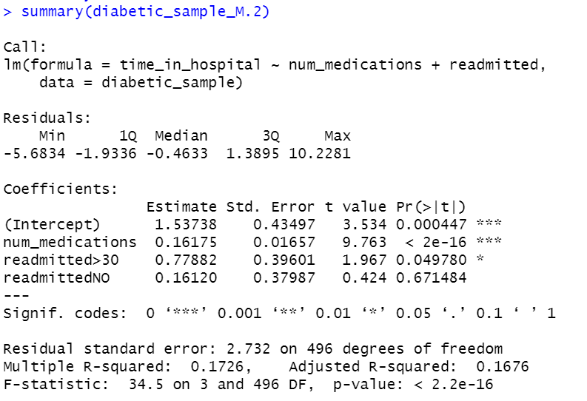

Slide 12
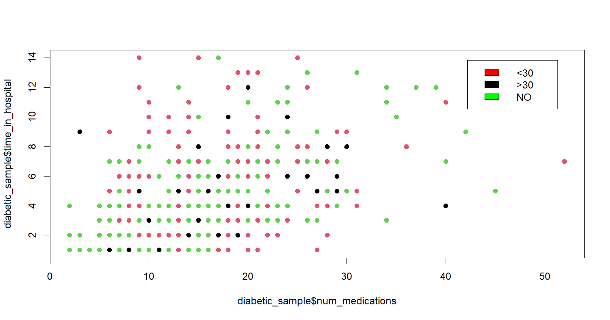

Slide 13
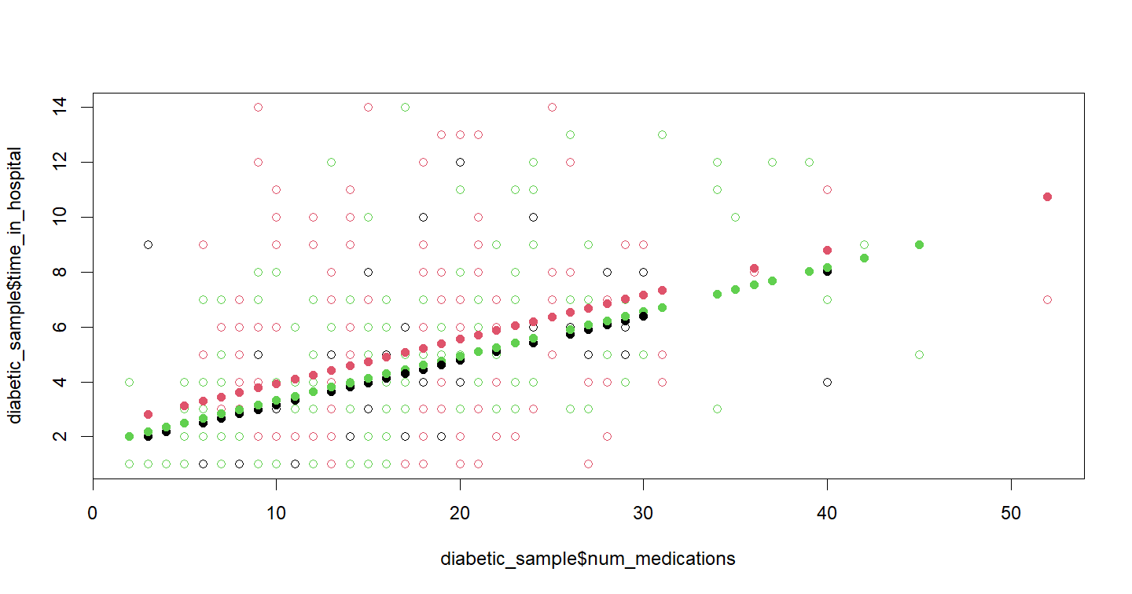

Slide 14
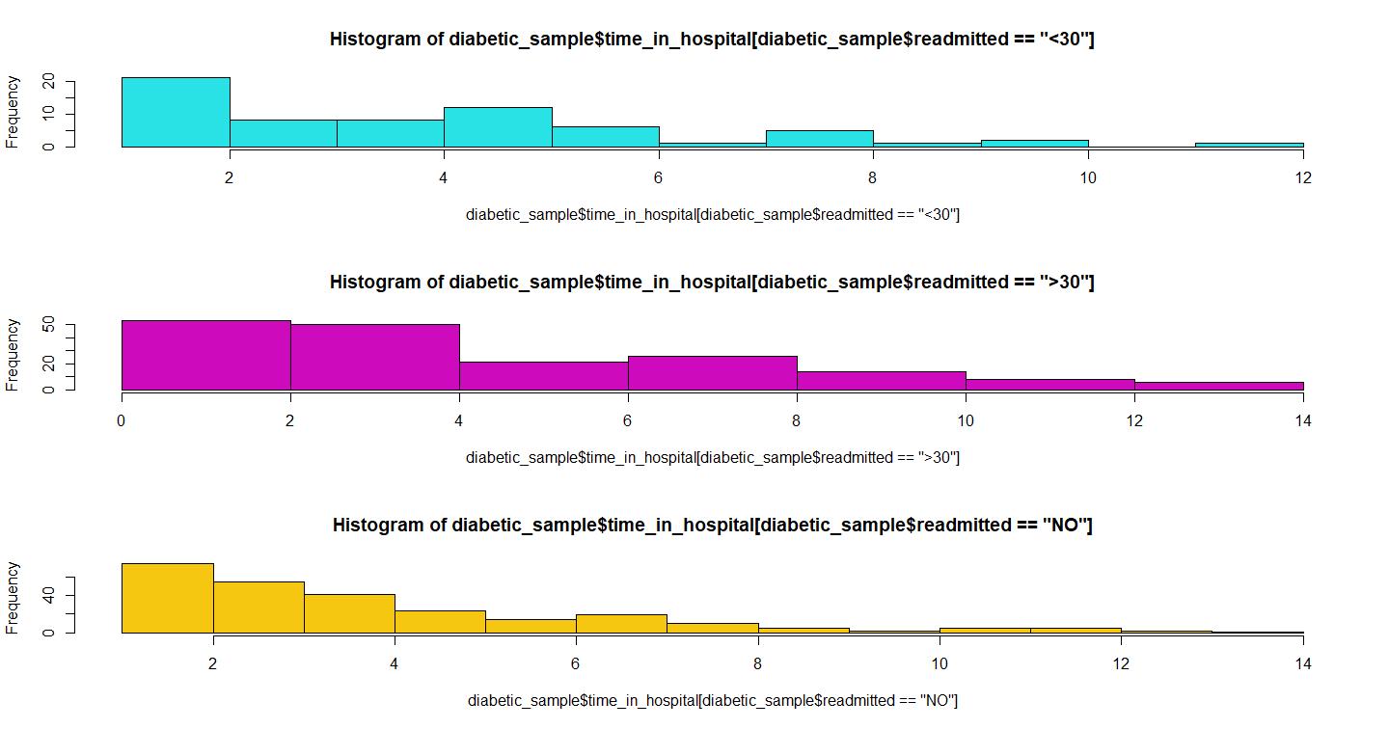

Slide 15
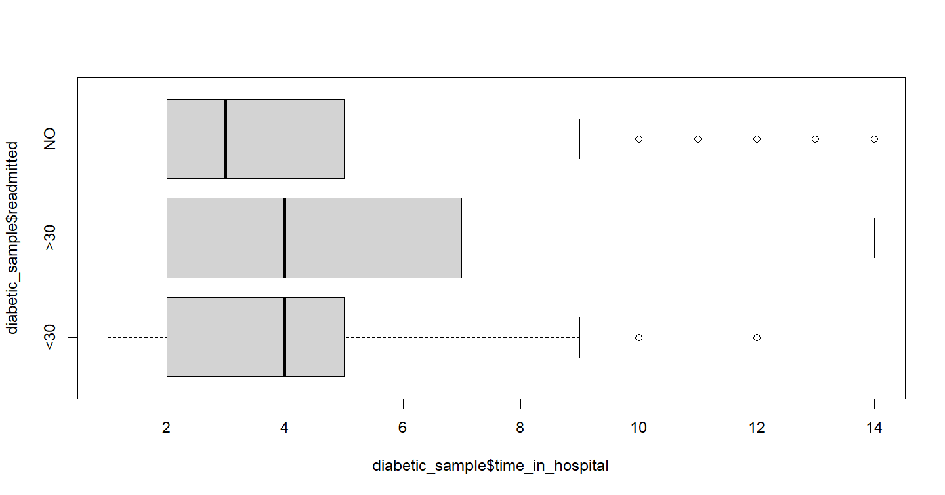
Visual comparison using boxplots to account for variability of observations within each group

Slide 16

ANOVA
We designate readmitted <30 as the base group
Outcome - time_in_hospital
$$\hat{y_{i}}=b_{0}+b_{1}({readmitted>30)}_{i}+b_{2 }({readmitted NO)}_{i}$$

Slide 17
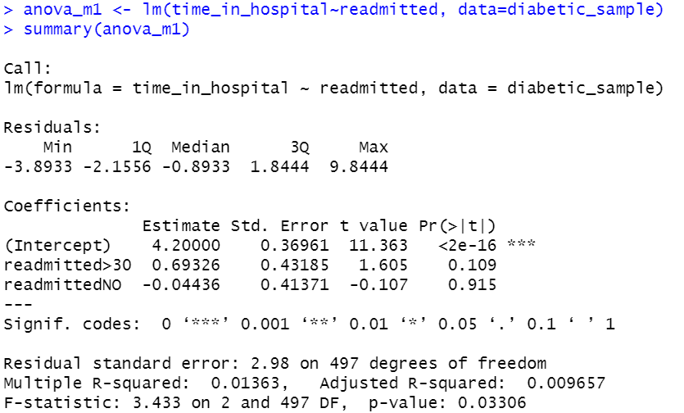

Slide 18
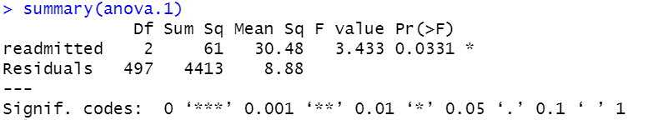
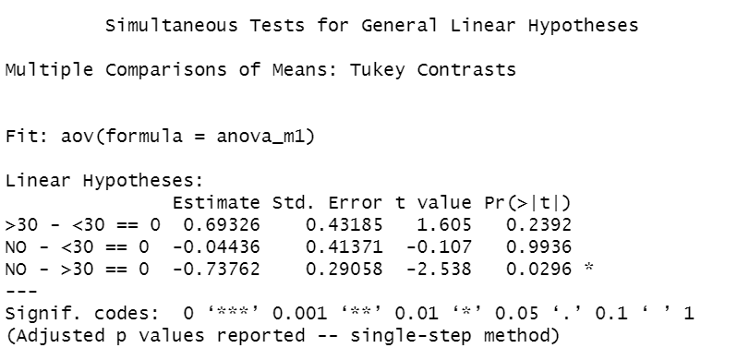
Tukey post hoc tests

Slide 19
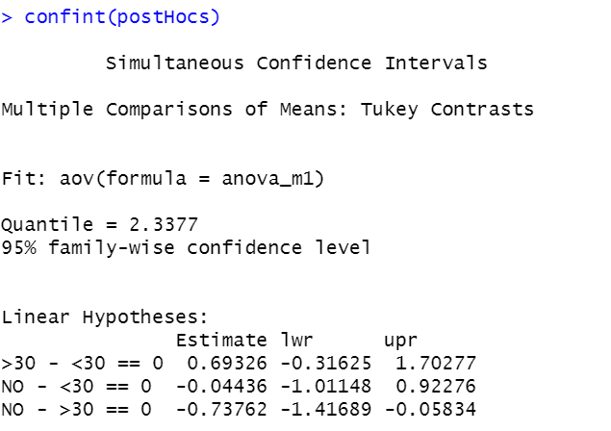

Slide 20
THANK YOU

